Slide 1
Lesson 5: Stacking and Blending

Slide 2
Week 3 Survey
Highlights
The response rate is very high for ML.
Students seem unanimously appreciated class structure and approach from multiple angles- demo, exercises, theory etc. which is great.
Students feel the class is broken down well and class discussion is engaging.
To be Improved
There are 4-5 comments to include more depth on the algorithms/math
Length of the class. Leverage extra time to include mode depth.

Slide 3
Today's Agenda
Combine classifiers
Stacking
Blending

Slide 4
Learning Objectives
By the end of this session, you should be able to:
Describe the theory of how ensemble learning reduces errors.
Use stacking to improve model performance.
Use blending to improve model performance.

Slide 5
Recap
Lesson 3 Assignment Solution
SVM Recap

Slide 6
SVM Recap
Maximum Margin
Hinge loss
SVM with linear kernel
Kernel tricks
SVM with polynomial kernel
SVM with radial basis function kernel
Support Vector Regression

Slide 7
Weak Learner & Strong Learner
A weak learner: it can make predictions (slightly) better than random guessing.
Weak learners have high bias and cannot solve hard learning problems.
e.g., naïve Bayes, logistic regression, decision stumps (decision trees of depth 1)
A strong learner: it has arbitrarily small error rate.
Strong learners are our goal of machine learning.
e.g., random forest, deep neural networks

Slide 8
Can we turn weak learners into a strong one?
Weak Learner 1
Weak Learner 2
Weak Learner 3
Strong Learner
…
Weak Learner K
YES, ENSEMBLE LEARNING

Slide 9
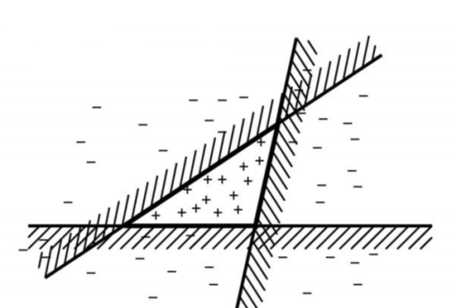
Ensemble Learning Intuition
Fable of blind men and elephant
Combine 3 linear classifiers

Slide 10
Ensemble Learning
Instead of learning a single classifier, we learn a set of classifiers.
Combine the predictions of multiple classifiers to produce the final prediction.
How do we learn a set of classifiers?
How do we combine all the classifiers? Can you give real-life example

Slide 11
Bagging
Varies data set
Each training set a bootstrap sample
bootstrap sample - select set of examples (with replacement) from original sample
Algorithm:
for k = 1 to #classifiers
train´ = bootstrap sample of train set
create classifier using train´ as training set
combine classifications using simple voting

Slide 12
Weak Learning
Schapire showed that a set of weak learners (learners with > 50% accuracy, but not much greater) could be combined into a strong learner
Idea: weight the data set based on how well we have predicted data points so far
data points predicted accurately - low weight
data points mispredicted - high weight
Result: focuses components on portion of data space not previously well predicted

Slide 13
Boosting
An iterative procedure to adaptively change distribution of training data by focusing more on previously misclassified records
Initially, all N records are assigned equal weights
Unlike bagging, weights may change at the end of a boosting round

Slide 14
Boosting
Records that are wrongly classified will have their weights increased
Records that are classified correctly will have their weights decreased
Example 4 is hard to classify
Its weight is increased, therefore it is more likely to be chosen again in subsequent rounds

Slide 15
Boosting
Equal weights are assigned to each training instance (1/N for round 1) at first round
After a classifier C_{i} is learned, the weights are adjusted to allow the subsequent classifier
C_{i+1} to “pay more attention” to data that were misclassified by C_{i}.
Final boosted classifier C* combines the votes of each individual classifier
Weight of each classifier’s vote is a function of its accuracy
Adaboost – popular boosting algorithm

Slide 16
Adaboost (Adaptive Boost)
Input:
Training set D containing N instances
T rounds
A classification learning scheme
Output:
A composite model

Slide 17
Boosting - Adaboost: Training Phase
Training data D contain N labeled data (X₁,y₁), (X₂,y₂ ), (X₃,y₃),….(X_{N},y_{N})
Initially assign equal weight 1/d to each data
To generate T base classifiers, we need T rounds or iterations
Round i, data from D are sampled with replacement , to form Di (size N)
Each data’s chance of being selected in the next rounds depends on its weight
Each time the new sample is generated directly from the training data D with different sampling probability according to the weights; these weights are not zero

Slide 18
Boosting - Adaboost: Training Phase
Base classifier C_{i}, is derived from training data of Di
Error of C_{i} is tested using Di
Weights of training data are adjusted depending on how they were classified
Correctly classified: Decrease weight
Incorrectly classified: Increase weight
Weight of a data indicates how hard it is to classify it (directly proportional)

Slide 19
Boosting - Adaboost: Testing Phase
The lower a classifier error rate, the more accurate it is, and therefore, the higher its weight for voting should be
Weight of a classifier C_{i}’s vote is
Testing:
For each class c, sum the weights of each classifier that assigned class c to X (unseen data)
The class with the highest sum is the WINNER!

Slide 20
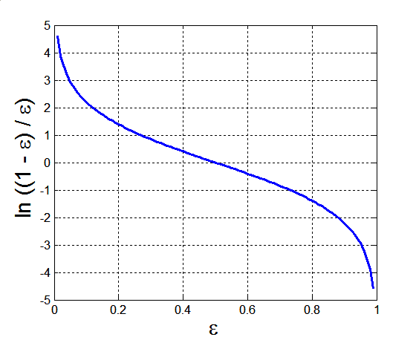
Example: Error and Classifier Weight in AdaBoost
Base classifiers: C₁, C₂, …, C_{T}
Error rate: (i = index of classifier, j=index of instance)
Importance of a classifier:
21

Slide 21
Boosting – Arcing Adapt[at]ive Resampling and Combining
Sample data set (like Bagging), but probability of data point being chosen weighted (like Boosting)
m_{i} = #number of mistakes made on point i by previous classifiers
probability of selecting point i :
Value 4 chosen empirically
Combine using voting

Slide 22
Why do ensembles work?
Suppose there are 25 classifiers where each classifier has an error rate of 0.35.
Assume classifiers are independent: a mistake from one classifier does not depend on the predictions from other classifiers.
In practice they are NOT completely independent.
Majority Voting: The ensemble makes a wrong prediction if the majority of the classifiers predict the wrong prediction.
What is the probability that the ensemble makes a wrong prediction? (hint: 13 or more classifiers make wrong predictions).

Slide 23
Why do ensembles work?
Suppose there are 25 base classifiers
Each classifier has error rate, ε = 0.35
Assume classifiers are independent
Probability that the ensemble classifier makes a wrong prediction:

Slide 24
How it works
Majority vote
Suppose we have 5 completely independent classifiers…
If accuracy is 70% for each
(.7⁵)+5(.7⁴)(.3)+ 10 (.7³)(.3²)
83.7% majority vote accuracy
101 such classifiers
99.9% majority vote accuracy
Note: Binomial Distribution: The probability of observing x heads in a sample of n independent coin tosses,
where in each toss the probability of heads is p, is

Slide 25
Value of Ensembles
“No Free Lunch” Theorem
No single algorithm wins all the time!
When combing multiple independent and diverse decisions each of which is at least more accurate than random guessing, random errors cancel each other out, correct decisions are reinforced.

Slide 26
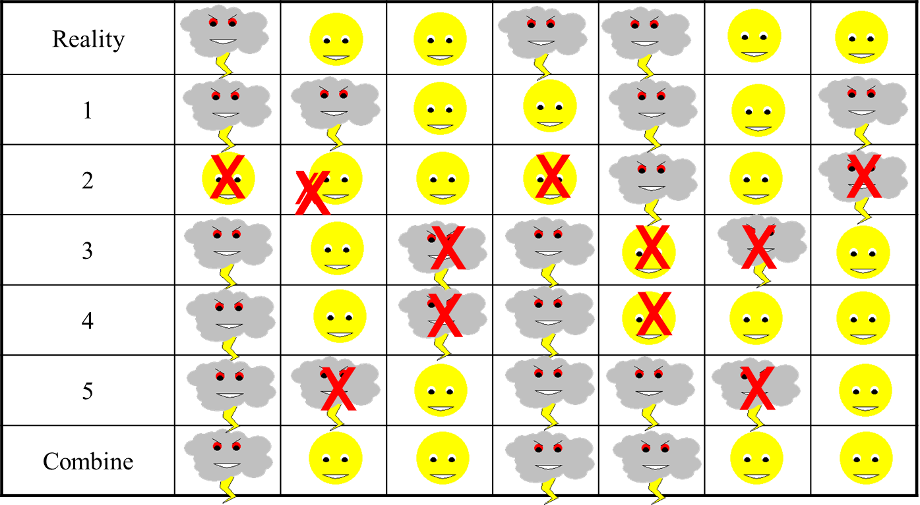
Example: Weather Forecast

Slide 27
Ensemble Mechanisms - Combiners
Voting
Averaging (if predictions not 0,1)
Weighted Averaging
base weights on confidence in component
Learning combiner
Stacking, Wolpert
general combiner
RegionBoosting, Maclin
piecewise combiner

Slide 28
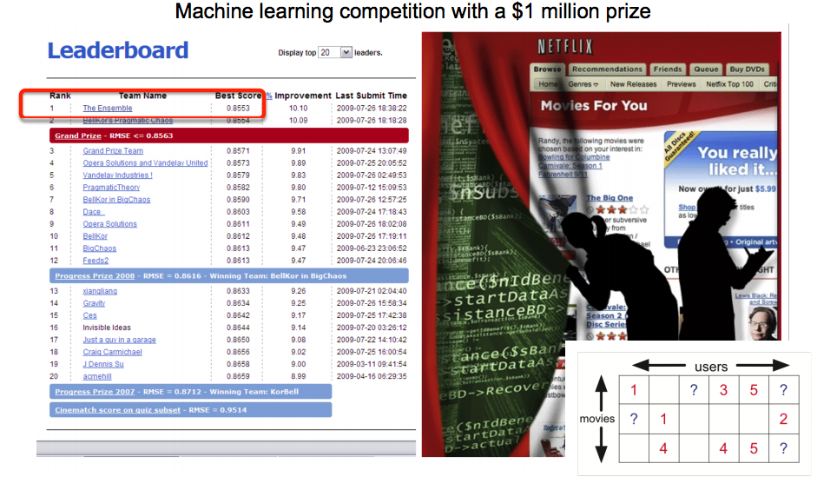
Ensemble Learning in Netflix Prize
The Ensemble was an ensemble solution of teams which had been competing individually for the prize.

Slide 29
Quiz
Which of the following algorithm is not an example of an ensemble method?
A. Extra Tree Regressor B. Random Forest C. Gradient Boosting D. Decision Tree

Slide 30
Quiz
What is true about an ensembled classifier?
1. Classifiers that are more “sure” can vote with more conviction 2. Classifiers can be more “sure” about a particular part of the space 3. Most of the times, it performs better than a single classifier
A. 1 and 2 B. 1 and 3 C. 2 and 3 D. All of the above

Slide 31
Quiz
Refer below table for models M1, M2 and M3.
Actual Output | M1 | M2 | M3 | Output
1 | 1 | 0 | 0
1 | 1 | 1 | 1
1 | 1 | 0 | 0
1 | 0 | 1 | 0
1 | 0 | 1 | 1
1 | 0 | 0 | 1
1 | 1 | 1 | 1
1 | 1 | 1 | 1
1 | 1 | 1 | 1
1 | 1 | 1 | 1
If you want to ensemble these models using majority voting. What will be the minimum accuracy you can get?
A. Always greater than 70% B. Always greater than and equal to 70% C. It can be less than 70% D. None of these

Slide 32
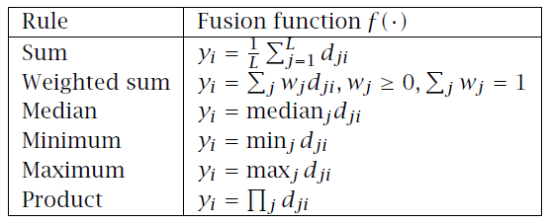
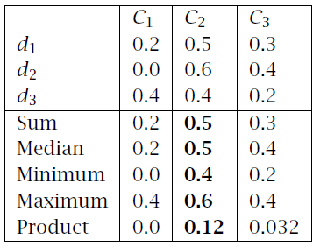
Fixed Combination Rules
Lecture Notes for E Alpaydın 2010 Introduction to Machine Learning 2e © The MIT Press (V1.0)

Slide 33
Stacking
Stacking or Stacked Generalization is an ensemble machine learning algorithm.
It uses a meta-learning algorithm to learn how to best combine the predictions from two or more base machine learning algorithms.
The benefit of stacking is that it can harness the capabilities of a range of well-performing models on a classification or regression task and make predictions that have better performance than any single model in the ensemble.

Slide 34
Blending
Blending is an ensemble machine learning technique that uses a machine learning model to learn how to best combine the predictions from multiple contributing ensemble member models.
As such, blending is the same as stacked generalization, known as stacking, broadly conceived. Often, blending and stacking are used interchangeably in the same paper or model description.
Many machine learning practitioners have had success using stacking and related techniques to boost prediction accuracy beyond the level obtained by any of the individual models. In some contexts, stacking is also referred to as blending, and we will use the terms interchangeably here.
— Feature-Weighted Linear Stacking, 2009.

Slide 35
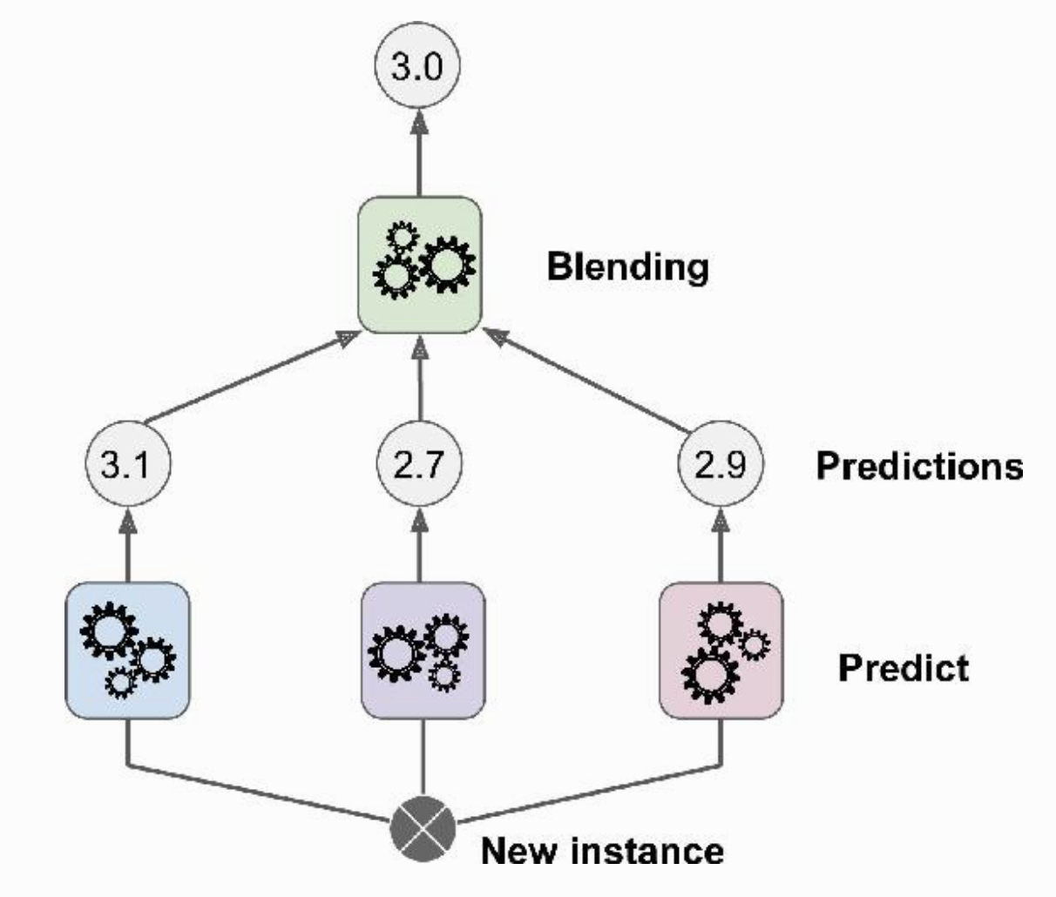
The Idea of Stacking
Instead of using trivial functions (such as majority voting / averaging) to aggregate the predictions of all predictors in an ensemble, we train a model (aka blender) to perform this aggregation.

Slide 36
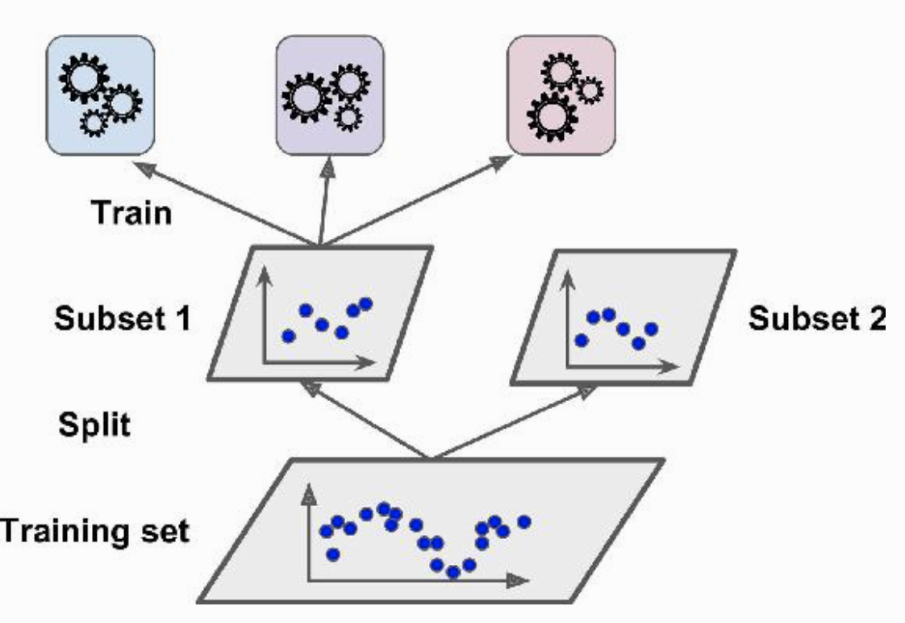
Training stacked model – Step 1
The training set is split in two subsets.
The first subset is used to train the predictors in the first layer.
The second subset is used to train the blender in the second layer.

Slide 37
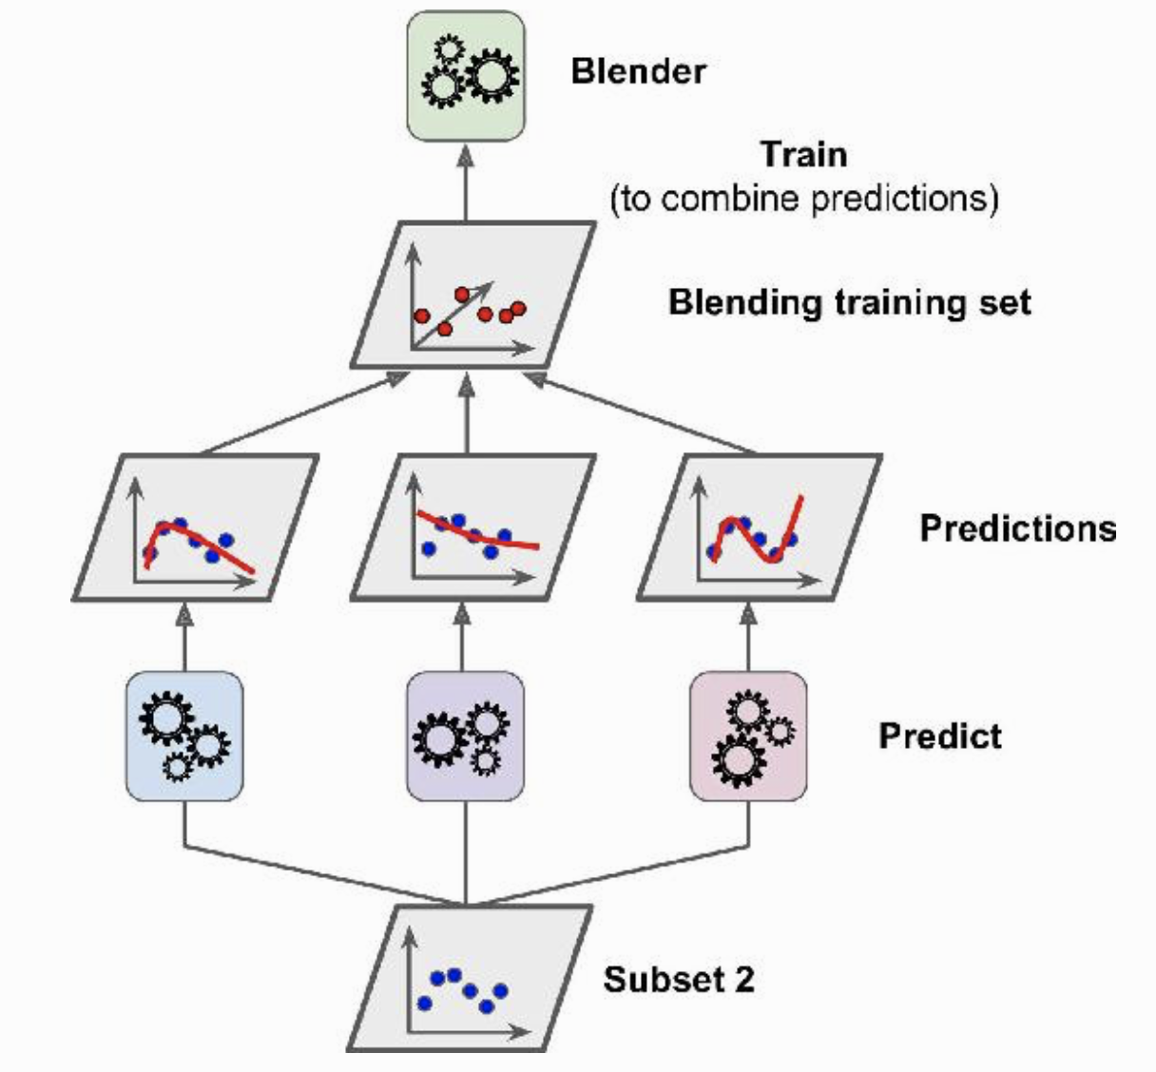
Training stacked model – Step 2
The first layer predictors are used to make predictions on the second subset.
Create a new training set using these predicted values as input features.
The blender is trained on this new training set, so it learns to predict the target value given the first layer’s predictions.

Slide 38
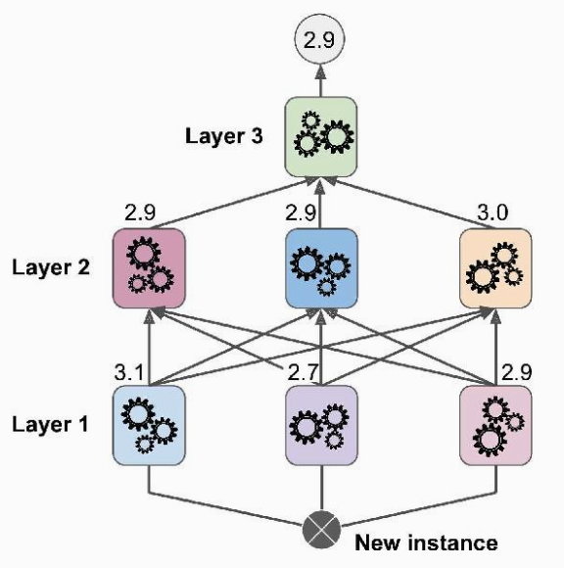
Multilayer Stacking Ensemble
We can easily extend the 2-layer stacking model to multi-layer stacking.
Split the original training data into K subsets for a K-layer stacking model.
The i^{th} subset of the data is used to learn the blenders in the i^{th} layer to avoid data leakage.

Slide 39
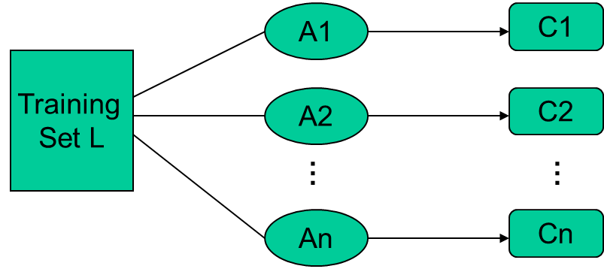
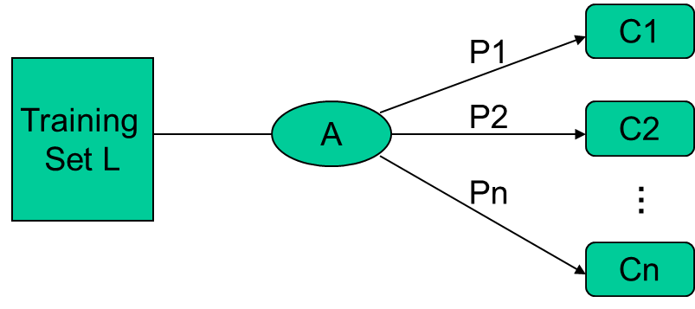
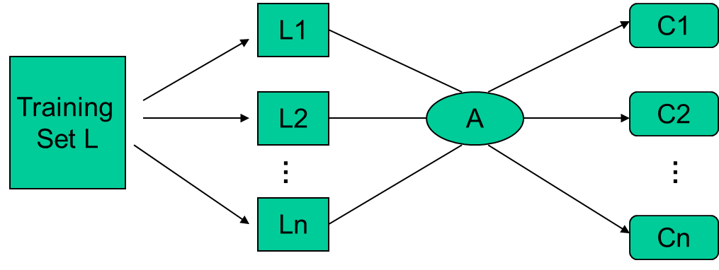
Types of Ensemble Learning
Different learning algorithms
Algorithms with different choice for parameters
Data set with different features (e.g. random subspace)
Data set = different subsets (e.g. bagging, boosting)

Slide 40
General Idea
Eick: Ensemble Learning

Slide 41
How to Combine Classifiers
Voting:
Classifiers are combined in a static way
Each base-level classifier gives a (weighted) vote for its prediction
Plurality vote: each base-classifier predict a class
Stacking: a stack of classifiers
Classifiers are combined in a dynamically
A machine learning method is used to learn how to combine the prediction of the base-level classifiers.
Top level classifier is used to obtain the final prediction from the predictions of the base-level classifiers
Example
Example

Slide 42
Notebook Time

Slide 43
What is the Main Challenge for Developing Ensemble Models?
The main challenge is not to obtain highly accurate base models, but rather to obtain base models which make different kinds of errors.
For example, if ensembles are used for classification, high accuracies can be accomplished if different base models misclassify different training examples, even if the base classifier accuracy is low. Independence between two base classifiers can be assessed in this case by measuring the degree of overlap in training examples they misclassify (|A ∩B|/|A∪B|)—more overlap means less independence between two models.

